Slide 1
All-Pairs Testing
taught by: Dan Tripp

Slide 2
The Problem (slide 1 of 2)
Parameter | Values | Number of tests (cumulative)
Number of columns | 1, 2, 4 | 3
Blog CMS | Drupal, Wordpress, Joomla | 3*3 = 9
Blog post - number of comments | 0, 1, 2, 10 | 3*3*4 = 36
Browser | Chrome, Firefox, Edge | 3*3*4*3 = 108
Layout | Desktop, Mobile | 3*3*4*3*2 = 216
Operating System | Windows, macOS, Ubuntu | 3*3*4*3*2*3 = 648
High Contrast Mode | On, Off | 3*3*4*3*2*3*2 = 1296
Viewport width | 1280, 640, 320 | 3*3*4*3*2*3*2*3 = 3888

Slide 3
The Problem (slide 2 of 2)
Number of parameters | Number of tests
1 | 3
2 | 9
3 | 36
4 | 108
5 | 216
6 | 648
7 | 1296
8 | 3888

Slide 4
The Crucial Observation (slide 1 of 2)
Number of parameters involved in bugs | Cumulative percent of bugs
1 | 29%
2 | 76%
3 | 95%
4 | 97%
5 | 99%
6 | 100%
Sources: “Introduction to Combinatorial Testing, Kuhn” et al., 2013, page 3-4, 202. “An investigation of the applicability of design of experiments to software testing”, Kuhn, IEEE Xplore, January 2003.

Slide 5
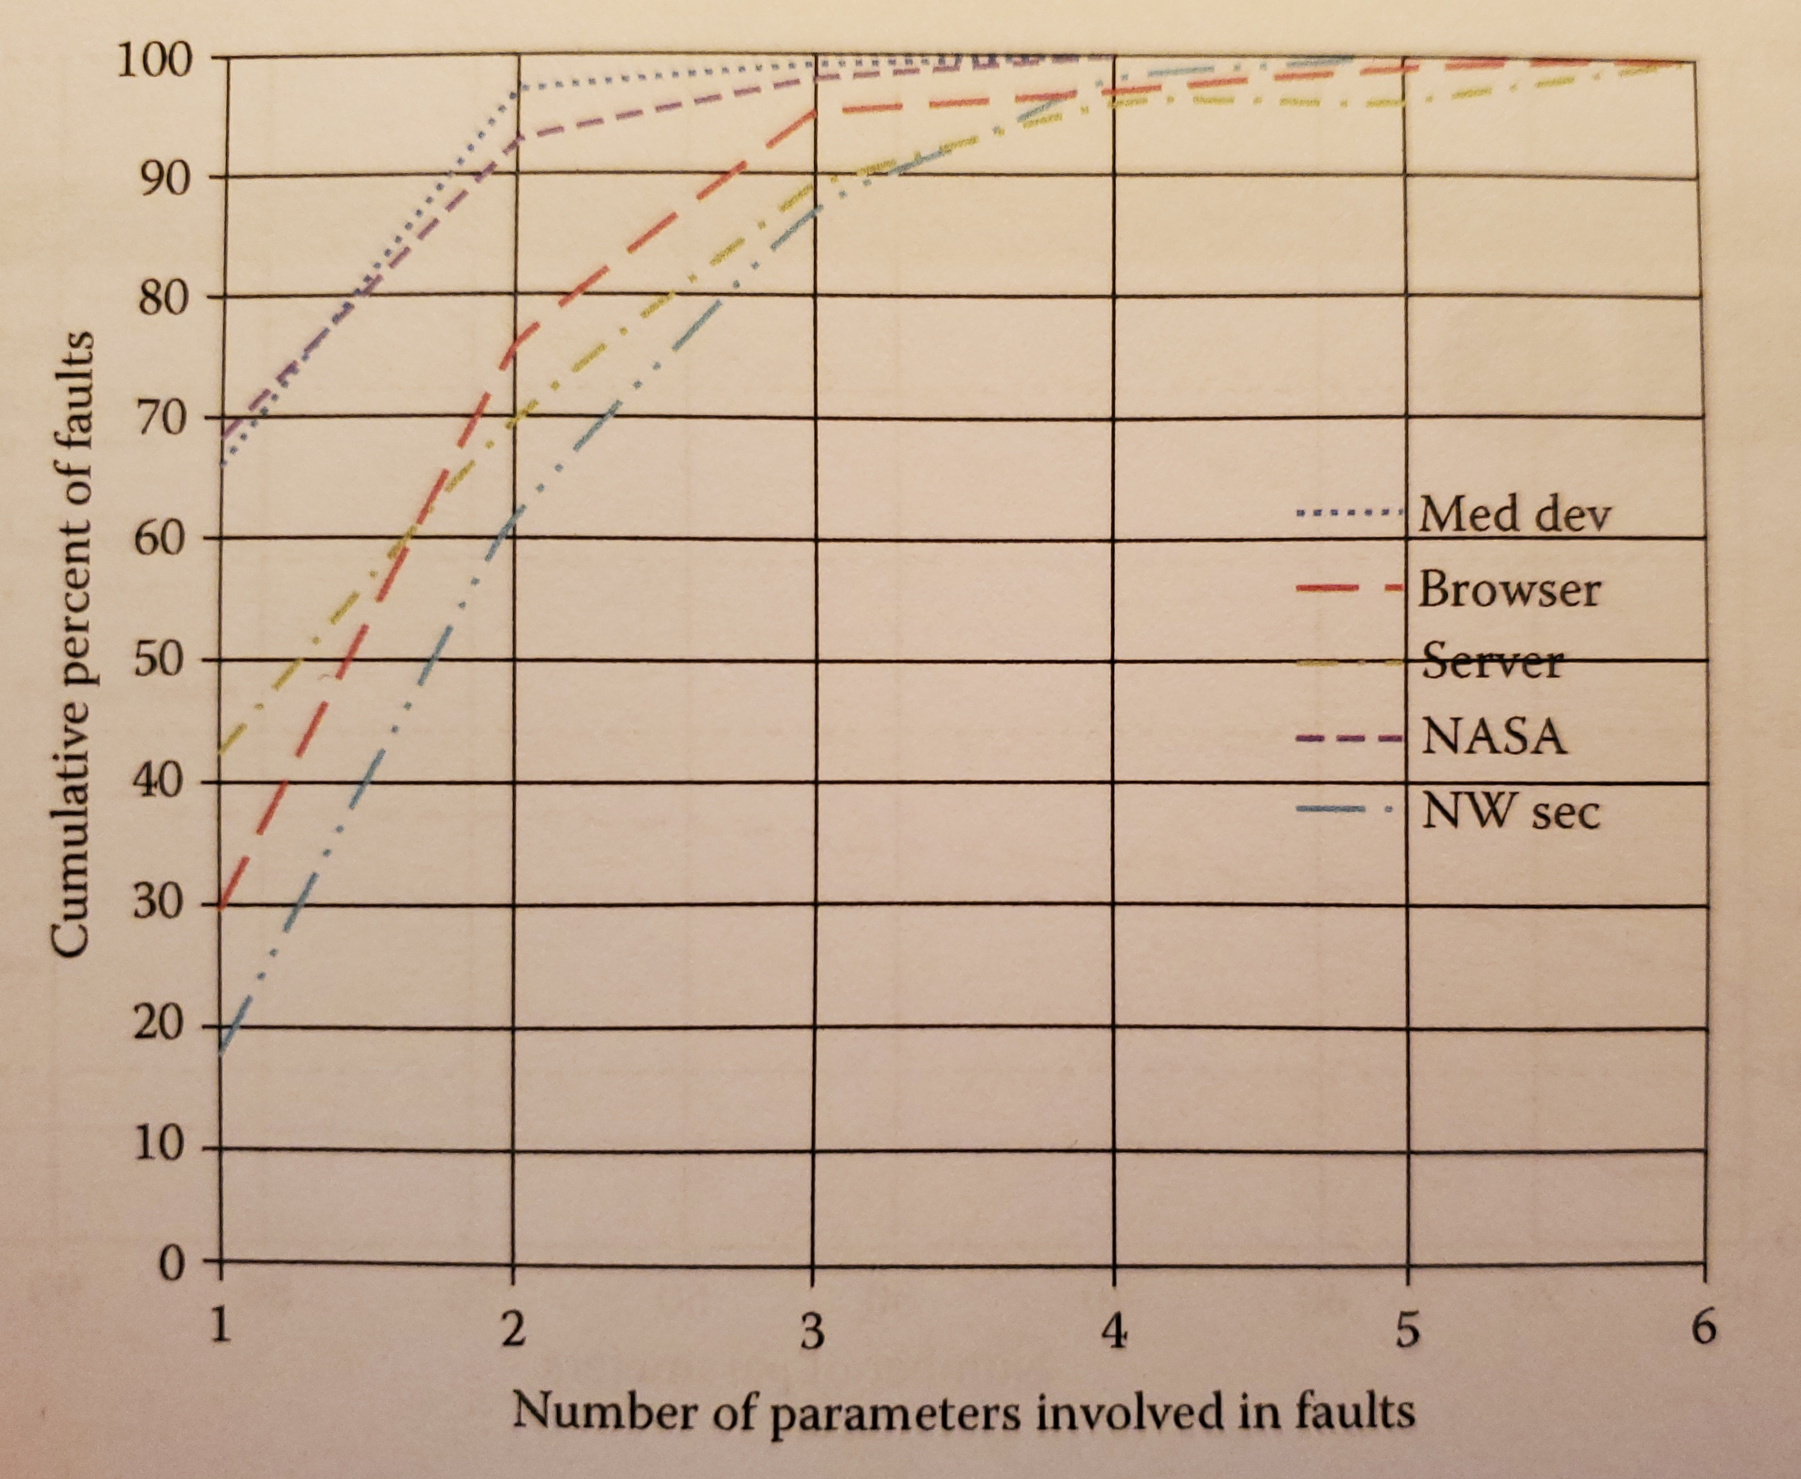
The Crucial Observation (slide 2 of 2)
 | Cumulative percent of faults
Num params | Med dev | Browser | Server | NASA | NW sec
1 | 65% | 29% | 43% | 67% | 18%
2 | 96% | 76% | 70% | 93% | 62%
3 | 98% | 95% | 89% | 98% | 86%
4 | 100% | 97% | 96% | 100% | 96%
5 | 100% | 99% | 96% | 100% | 100%
6 | 100% | 100% | 100% | 100% | 100%
Sources: “Introduction to Combinatorial Testing, Kuhn” et al., 2013, page 3-4, 202. “An investigation of the applicability of design of experiments to software testing”, Kuhn, IEEE Xplore, January 2003.

Slide 6
All-pairs – manually generated (slide 1 of 3)
Our parameters:
BROWSER: firefox, chrome
LAYOUT: desktop, mobile
PALETTE: forced_palette,
normal_colors
List of tests - exhaustive:
BROWSER LAYOUT PALETTE
test 1: chrome desktop forced_palette
test 2: chrome desktop normal_colors
test 3: chrome mobile forced_palette
test 4: chrome mobile normal_colors
test 5: firefox desktop forced_palette
test 6: firefox desktop normal_colors
test 7: firefox mobile forced_palette
test 8: firefox mobile normal_colors

Slide 7
All-pairs – manually generated (slide 2 of 3)
List of combinations: the "all-pairs wish list":
BROWSER/LAYOUT:
chrome desktop
chrome mobile
firefox desktop
firefox mobile
BROWSER/PALETTE:
chrome forced_palette
chrome normal_colors
firefox forced_palette
firefox normal_colors
LAYOUT/PALETTE:
mobile forced_palette
mobile normal_colors
desktop forced_palette
desktop normal_colors

Slide 8
All-pairs – manually generated (slide 3 of 3)
List of tests - exhaustive:
BROWSER LAYOUT PALETTE
test 1: chrome desktop forced_palette
test 2: chrome desktop normal_colors
test 3: chrome mobile forced_palette
test 4: chrome mobile normal_colors
test 5: firefox desktop forced_palette
test 6: firefox desktop normal_colors
test 7: firefox mobile forced_palette
test 8: firefox mobile normal_colors
List of tests - all pairs:
BROWSER LAYOUT PALETTE
test 2: chrome desktop normal_colors
test 3: chrome mobile forced_palette
test 5: firefox desktop forced_palette
test 8: firefox mobile normal_colors

Slide 9
All-pairs – tool-generated (slide 1 of 2)
Parameters:
NUM_COLUMNS: 1, 2, 4
BLOG_CMS: drupal, wordpress, joomla
BLOG_NUM_COMMENTS: 0, 1, 2, 10
BROWSER: firefox, chrome, edge
LAYOUT: desktop, mobile
PALETTE: forced_palette, normal_colors
OS: windows, macos, linux
VIEWPORT_WIDTH: 1280, 640, 320
Exhaustive tests: 3888
All-pairs tests: 17
Reduction: 99.6%

Slide 10
All-pairs – tool-generated (slide 2 of 2)
NUM_COLUMNS: 1, 2, 4
BLOG_CMS: drupal, wordpress, joomla
BLOG_NUM_COMMENTS: 0, 1, 2, 10
BROWSER: firefox, chrome, edge
LAYOUT: desktop, mobile
PALETTE: forced_palette, normal_colors
OS: windows, macos, linux
VIEWPORT_WIDTH: 1280, 640, 320
NUM_COLUMNS BLOG_CMS BLOG_NUM_COMMENTS BROWSER LAYOUT PALETTE OS VIEWPORT_WIDTH
1 drupal 0 firefox mobile forced_palette windows 640
1 drupal 2 firefox desktop forced_palette linux 1280
1 joomla 2 edge desktop normal_colors macos 1280
1 joomla 10 firefox mobile forced_palette linux 640
1 wordpress 0 edge desktop normal_colors windows 320
1 wordpress 1 chrome desktop forced_palette linux 640
1 wordpress 1 edge mobile forced_palette macos 1280
2 drupal 2 chrome desktop forced_palette windows 640
2 drupal 10 edge mobile normal_colors macos 320
2 joomla 0 chrome mobile forced_palette linux 1280
2 joomla 1 chrome desktop forced_palette windows 320
2 wordpress 0 firefox mobile forced_palette macos 320
2 wordpress 2 edge desktop normal_colors linux 640
4 drupal 0 chrome desktop forced_palette macos 1280
4 drupal 1 firefox desktop normal_colors macos 640
4 joomla 2 edge mobile normal_colors linux 320
4 wordpress 10 chrome desktop normal_colors windows 1280

Slide 11
Increasing number of parameters
Number of parameters | Number of tests
1 | 4
10 | 29
20 | 37
30 | 41
40 | 44
50 | 46
60 | 49
70 | 50
80 | 50
90 | 52
100 | 52
Source: https://math.nist.gov/coveringarrays/ipof/tables/table.2.4.html

Slide 12
Increasing number of values per parameter
Number of values per parameter | Number of tests for all pairs | Number of tests for all triplets | Number of tests for all quadruples
1 | 1 | 1 | 1
2 | 7 | 13 | 23
3 | 12 | 43 | 100
4 | 22 | 100 | 333
5 | 36 | 186 | 810
6 | 49 | 317 | 1695
7 | 66 | 497 | 3089
8 | 86 | 736 | 5252
9 | 108 | 1037 | 8385
10 | 130 | 1410 | 12743
Source: Dan Tripp

Slide 13
Infeasible combinations – the problem (slide 1 of 2)
OS: android, windows, ios
BROWSER: safari, edge, firefox, samsung_internet
LAYOUT: desktop, mobile
OS BROWSER LAYOUT
android edge desktop
android firefox mobile
android safari mobile
android samsung_internet desktop
ios edge mobile
ios firefox mobile
ios safari desktop
ios samsung_internet desktop
windows edge desktop
windows firefox desktop
windows safari mobile
windows samsung_internet mobile

Slide 14
Infeasible combinations – the problem (slide 2 of 2)
OS: android, windows, ios
BROWSER: safari, edge, firefox, samsung_internet
LAYOUT: desktop, mobile
OS BROWSER LAYOUT
android edge desktop
android firefox mobile
android safari mobile SKIP
android samsung_internet desktop
ios edge mobile
ios firefox mobile
ios safari desktop
ios samsung_internet desktop SKIP
windows edge desktop
windows firefox desktop
windows safari mobile SKIP
windows samsung_internet mobile SKIP

Slide 15
Infeasible combinations – the solution
OS: android, windows, ios
BROWSER: safari, edge, firefox, samsung_internet
LAYOUT: desktop, mobile
# New:
if [BROWSER] = "samsung_internet" then [OS] = "android";
if [BROWSER] = "safari" then [OS] = "ios";
OS BROWSER LAYOUT
android edge desktop
android firefox desktop
android samsung_internet desktop
android samsung_internet mobile
ios edge mobile
ios firefox mobile
ios safari desktop
ios safari mobile
windows edge desktop
windows firefox mobile

Slide 16
Ineffectual combinations – the problem
NUM_SEARCH_RESULTS: 0, 1, 2, 999
BROWSER: firefox, chrome, safari
LAYOUT: desktop, mobile
PALETTE: forced_palette, normal_colors
NUM_SEARCH_RESULTS BROWSER LAYOUT PALETTE
0 chrome desktop forced_palette
0 firefox mobile forced_palette
0 safari desktop normal_colors
1 chrome mobile normal_colors
1 firefox desktop normal_colors
1 safari desktop forced_palette
2 chrome desktop forced_palette
2 firefox desktop normal_colors
2 safari mobile normal_colors
999 chrome mobile forced_palette
999 firefox desktop normal_colors
999 safari desktop forced_palette

Slide 17
Ineffectual combinations – the solution
NUM_SEARCH_RESULTS: ~0, 1, 2, 999
# ^^ New: the "~" before the "0"
BROWSER: firefox, chrome, safari
LAYOUT: desktop, mobile
PALETTE: forced_palette, normal_colors
NUM_SEARCH_RESULTS BROWSER LAYOUT PALETTE
~0 chrome desktop forced_palette
~0 firefox mobile forced_palette
~0 safari desktop normal_colors
1 chrome desktop normal_colors
1 firefox mobile normal_colors
1 safari mobile forced_palette
2 chrome mobile normal_colors
2 firefox mobile forced_palette
2 safari desktop forced_palette
999 chrome mobile forced_palette
999 firefox desktop forced_palette
999 safari desktop normal_colors

Slide 18
Follow-up
https://linkedin.com/in/dan-tripp
daniel.john.tripp@gmail.com / dtr@siteimprove.com
https://dan-tripp-siteimprove.github.io/accessu-2023-all-pairs-testing

